Slide 1

NBA App

Slide 2

NBA.py
Install the nba-api library
Get NBA Teams, Games and Player stats
Build a multipage app

Slide 3
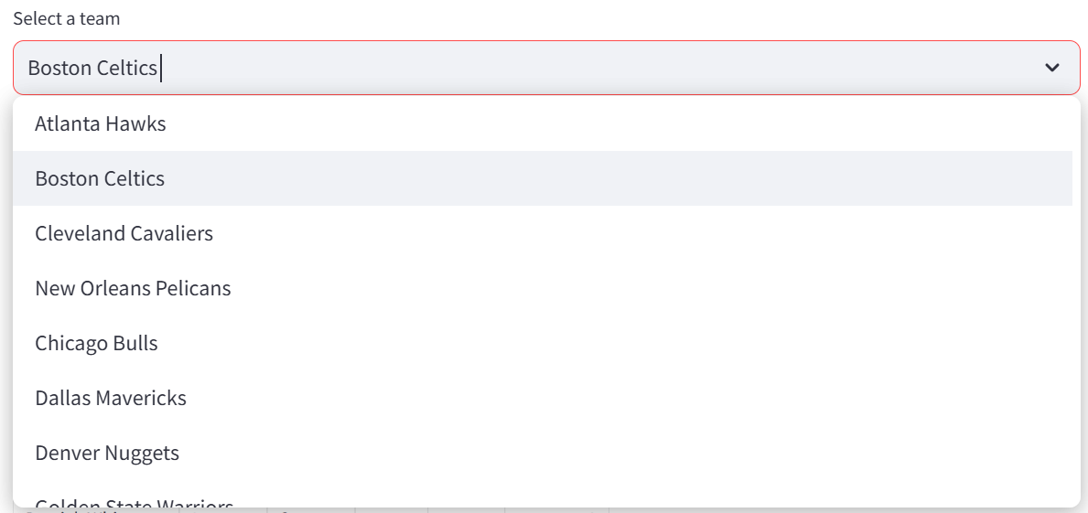
NBA Teams

Slide 4
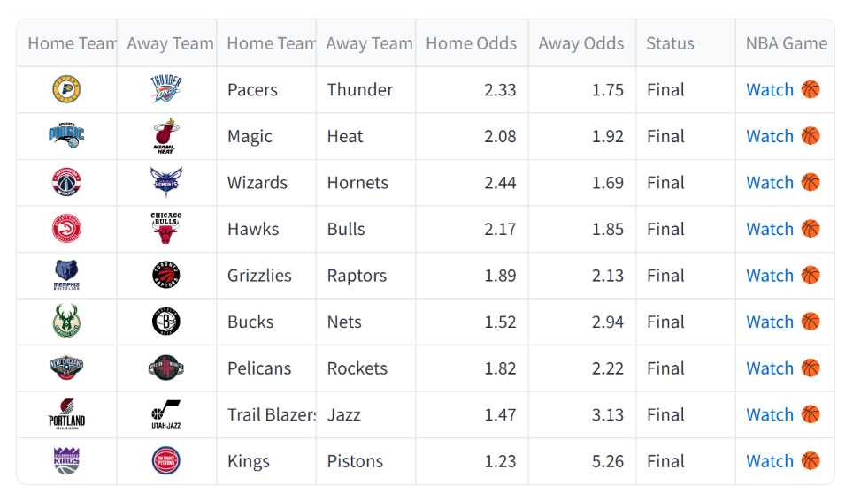
NBA Games

Slide 5

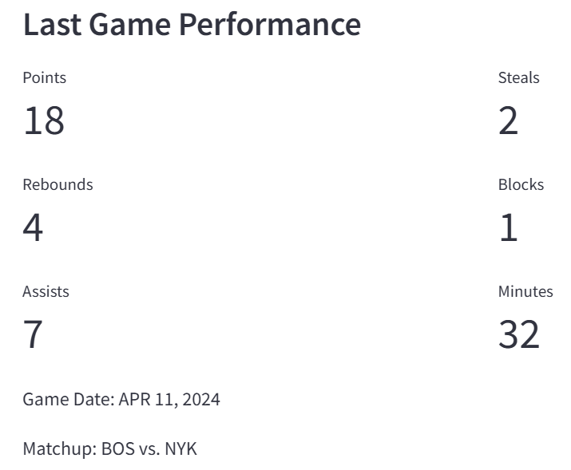
NBA Player Stats

Slide 6
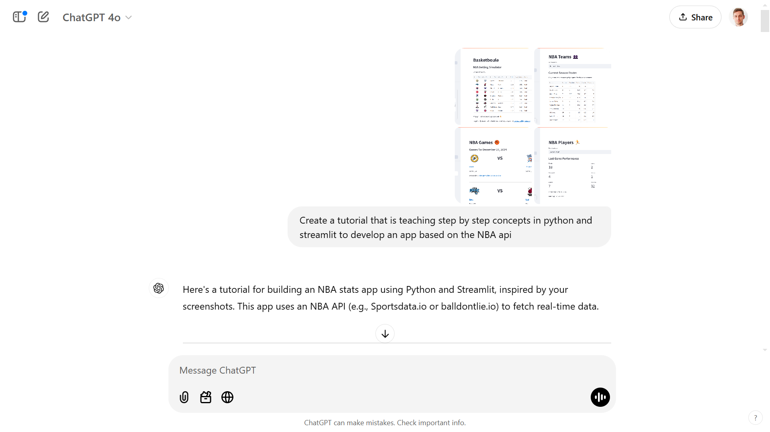

Slide 7
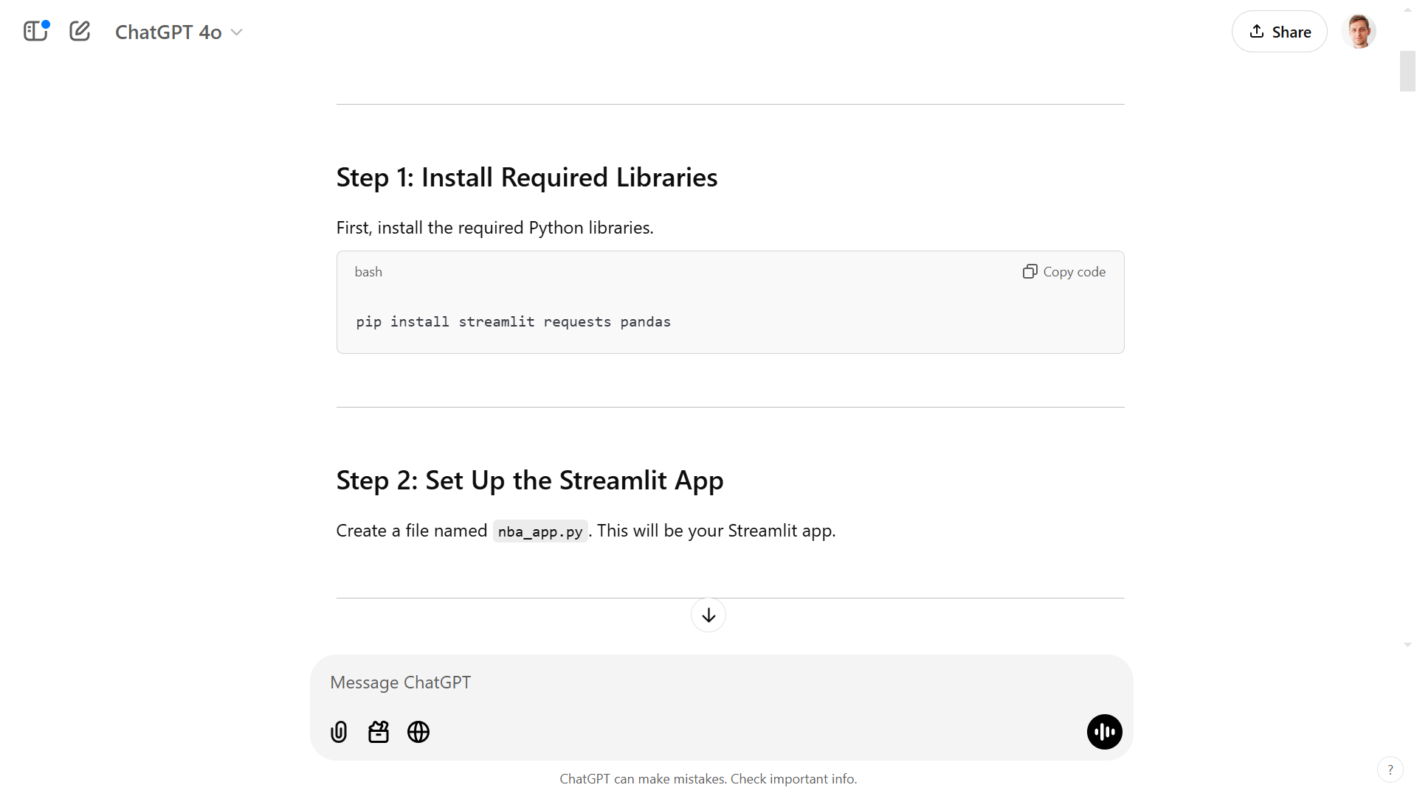
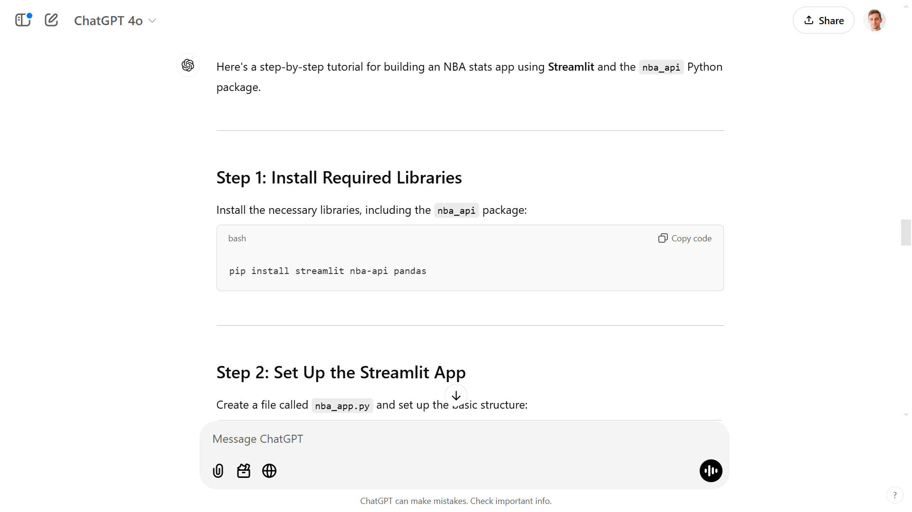

Slide 8
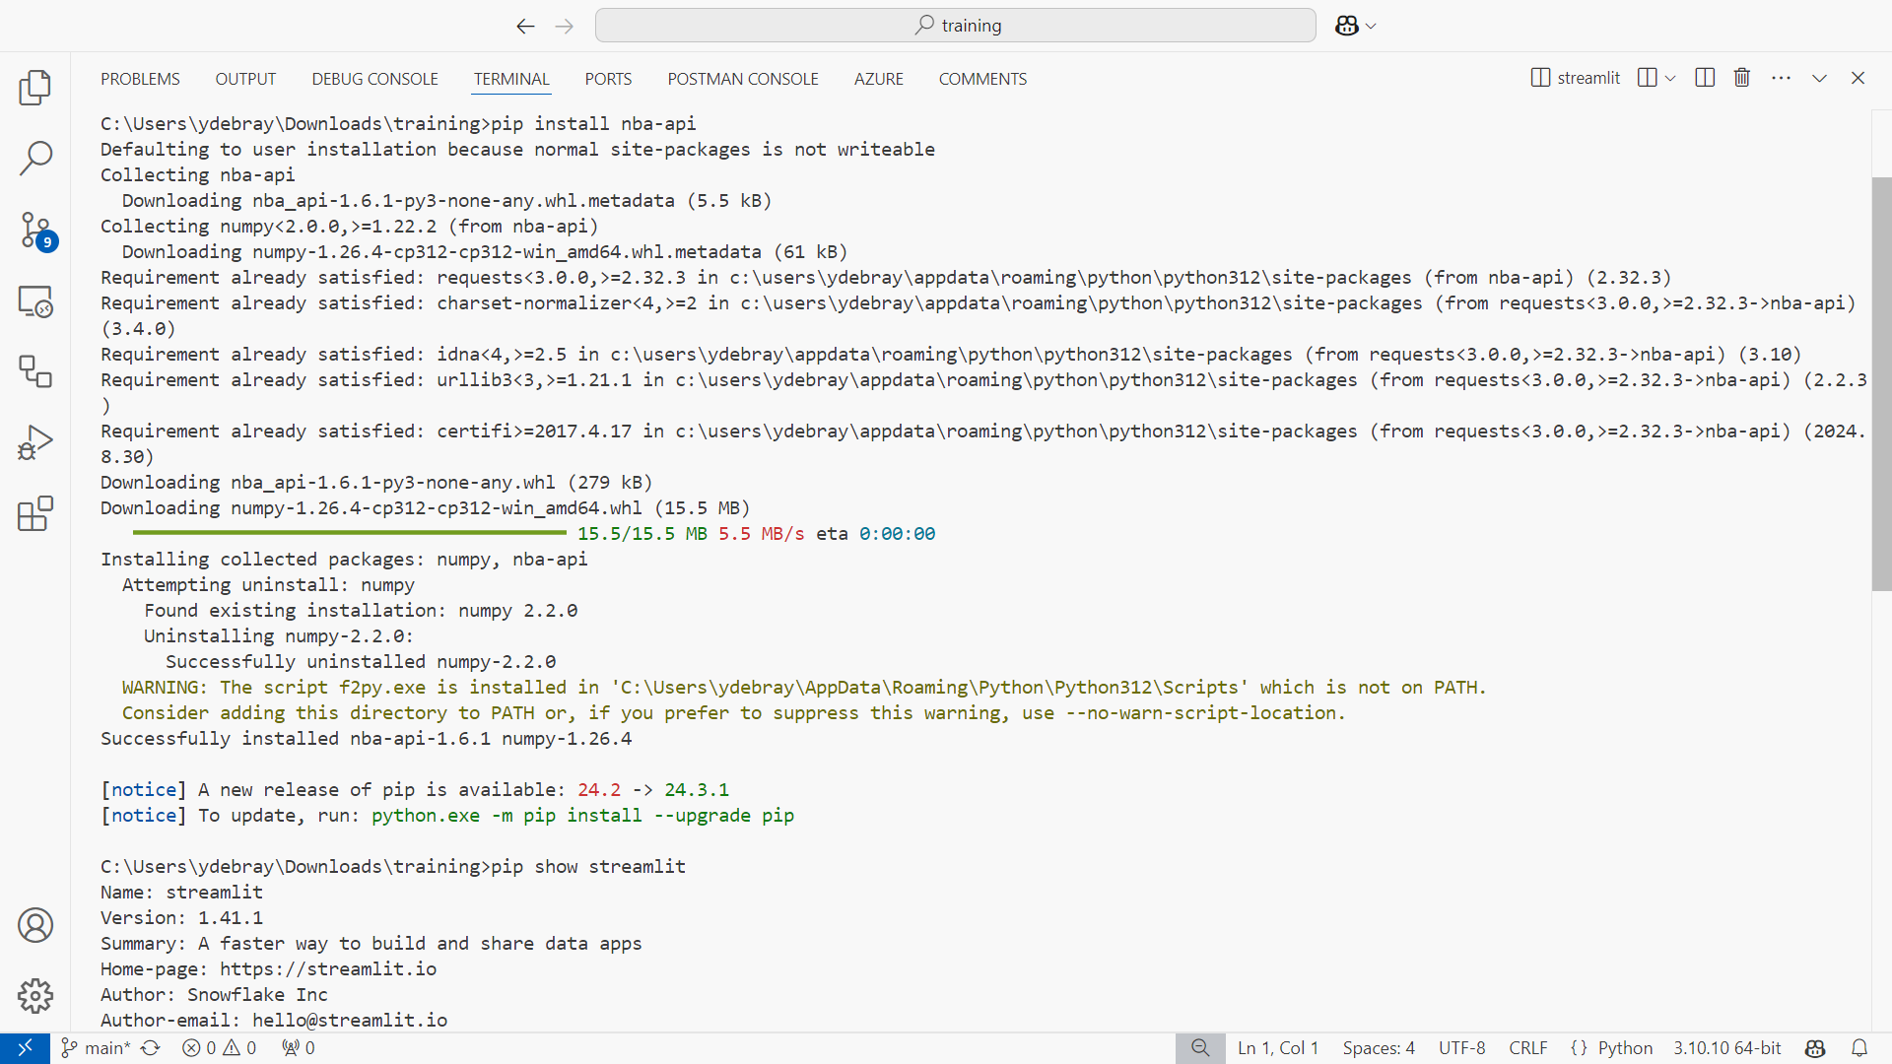

Slide 9
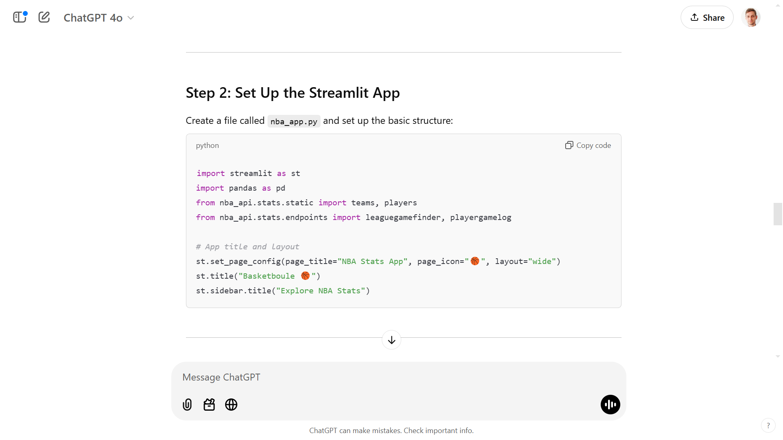

Slide 10
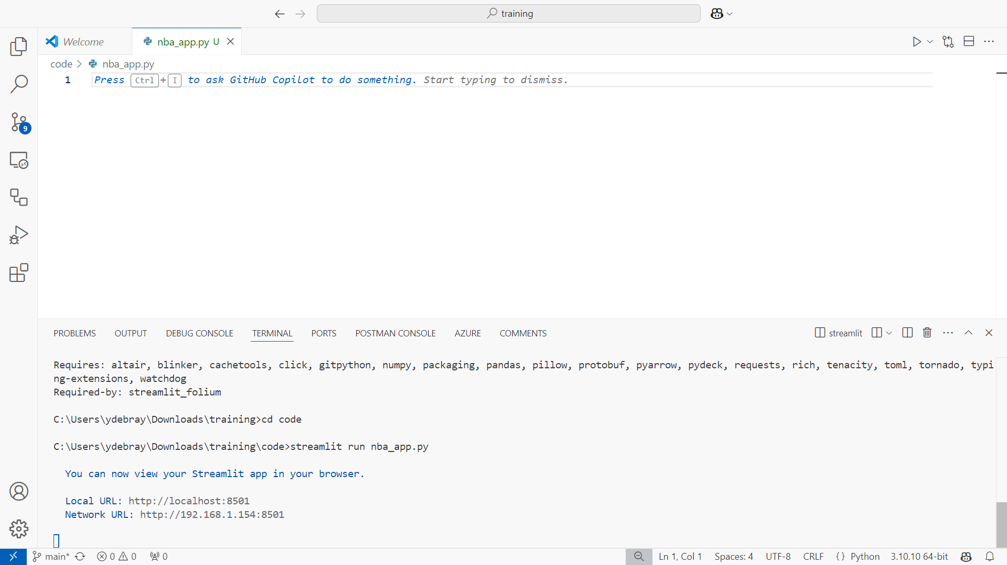
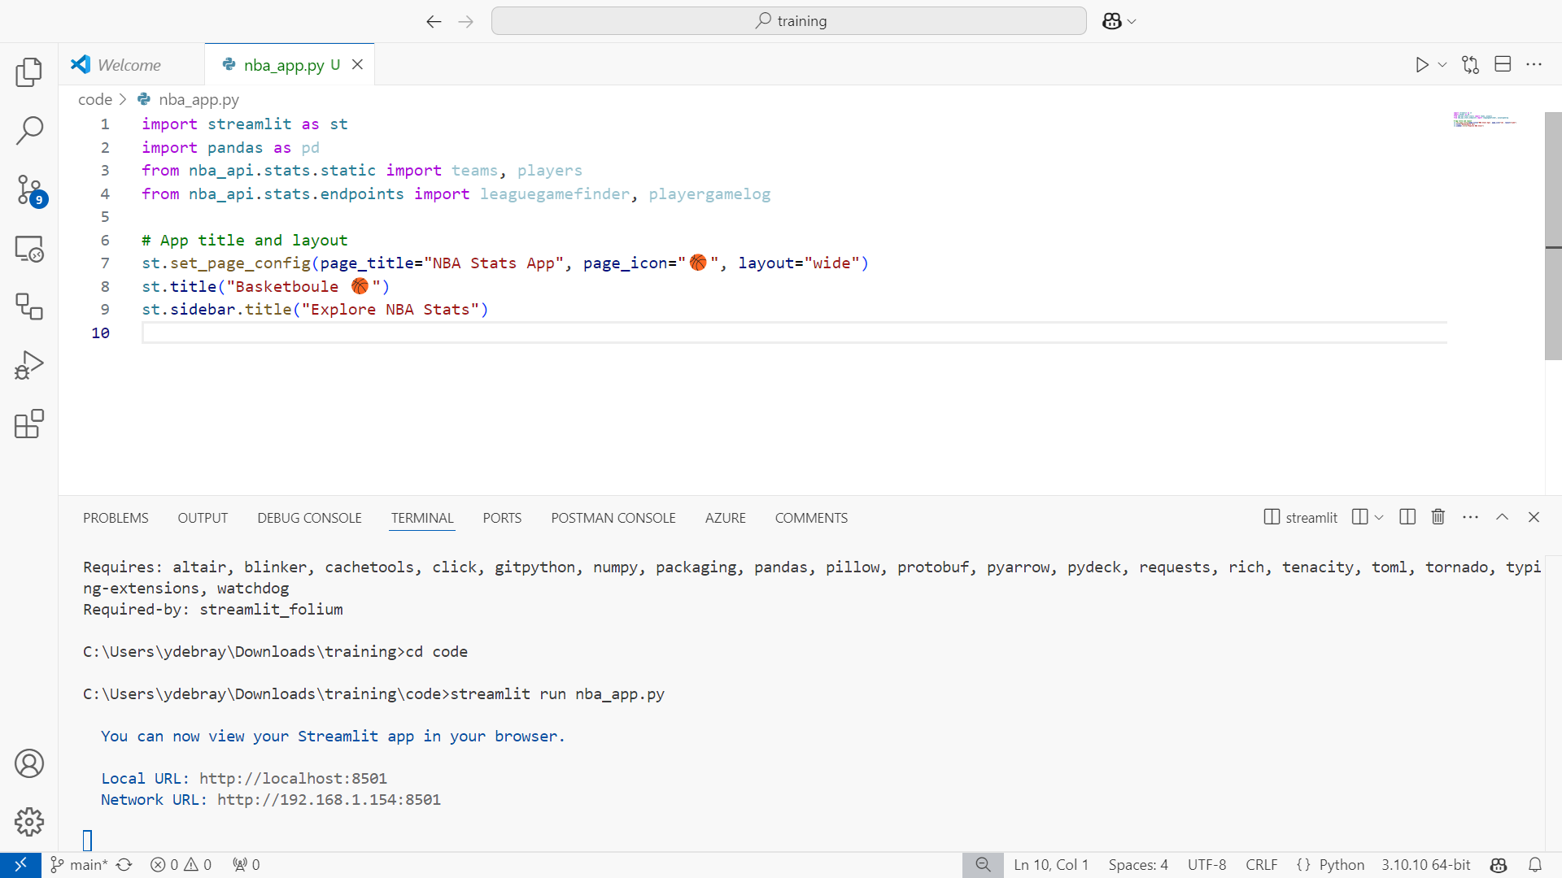

Slide 11
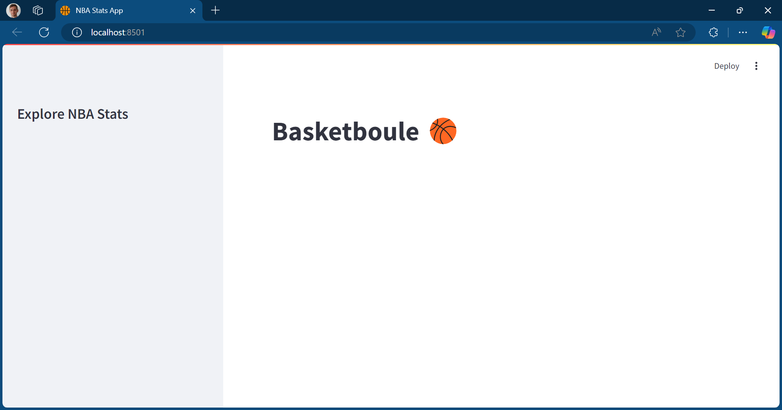

Slide 12
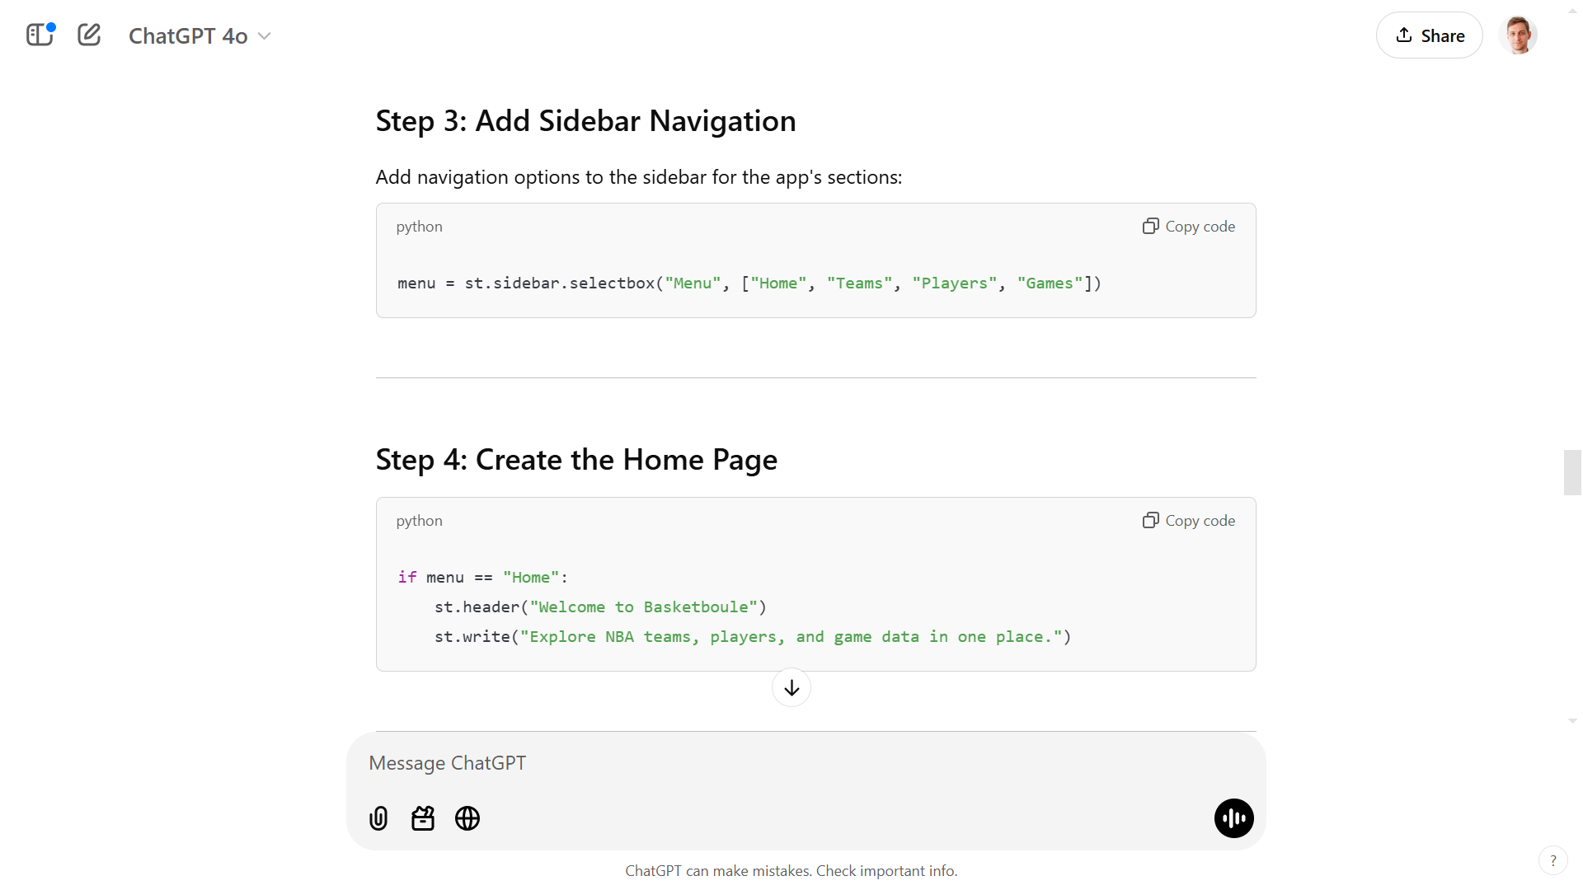

Slide 13
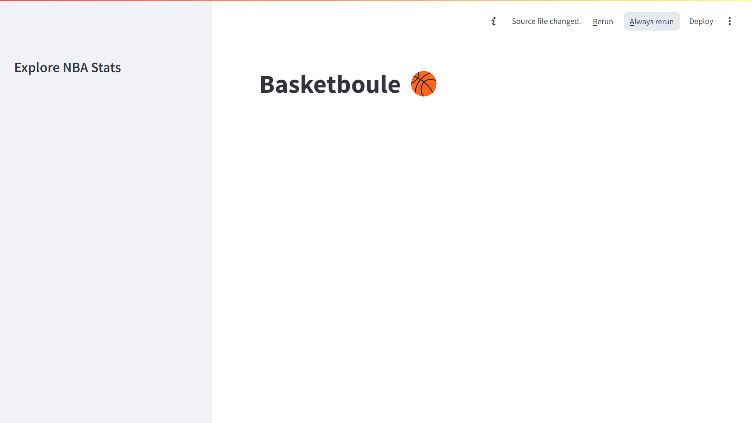

Slide 14
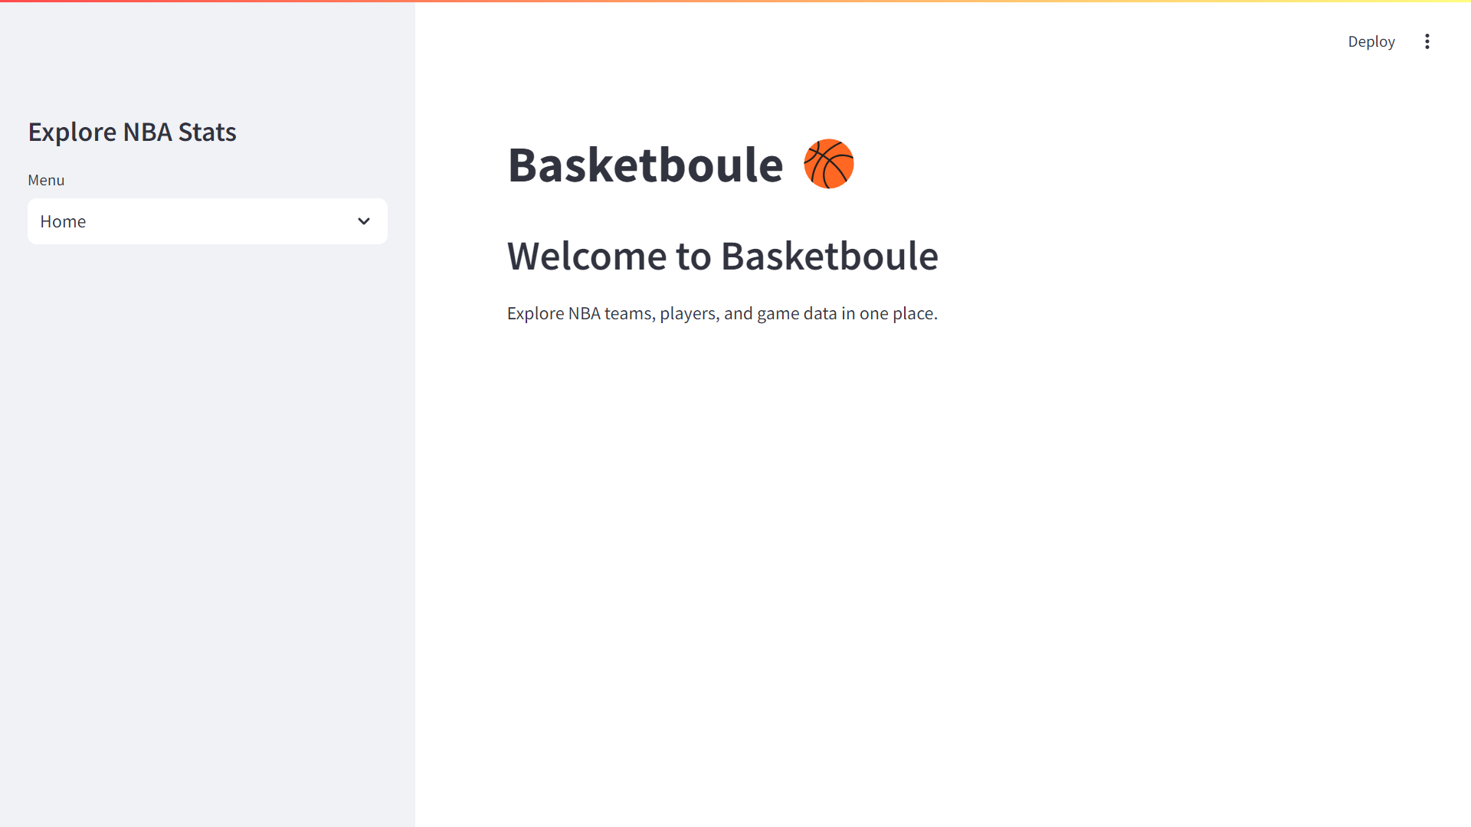

Slide 15
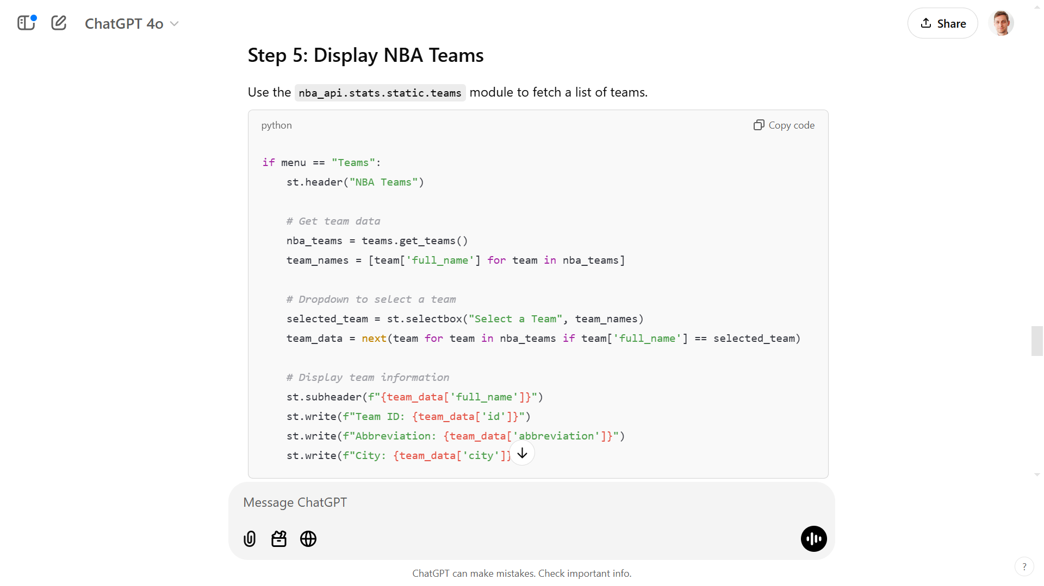

Slide 16
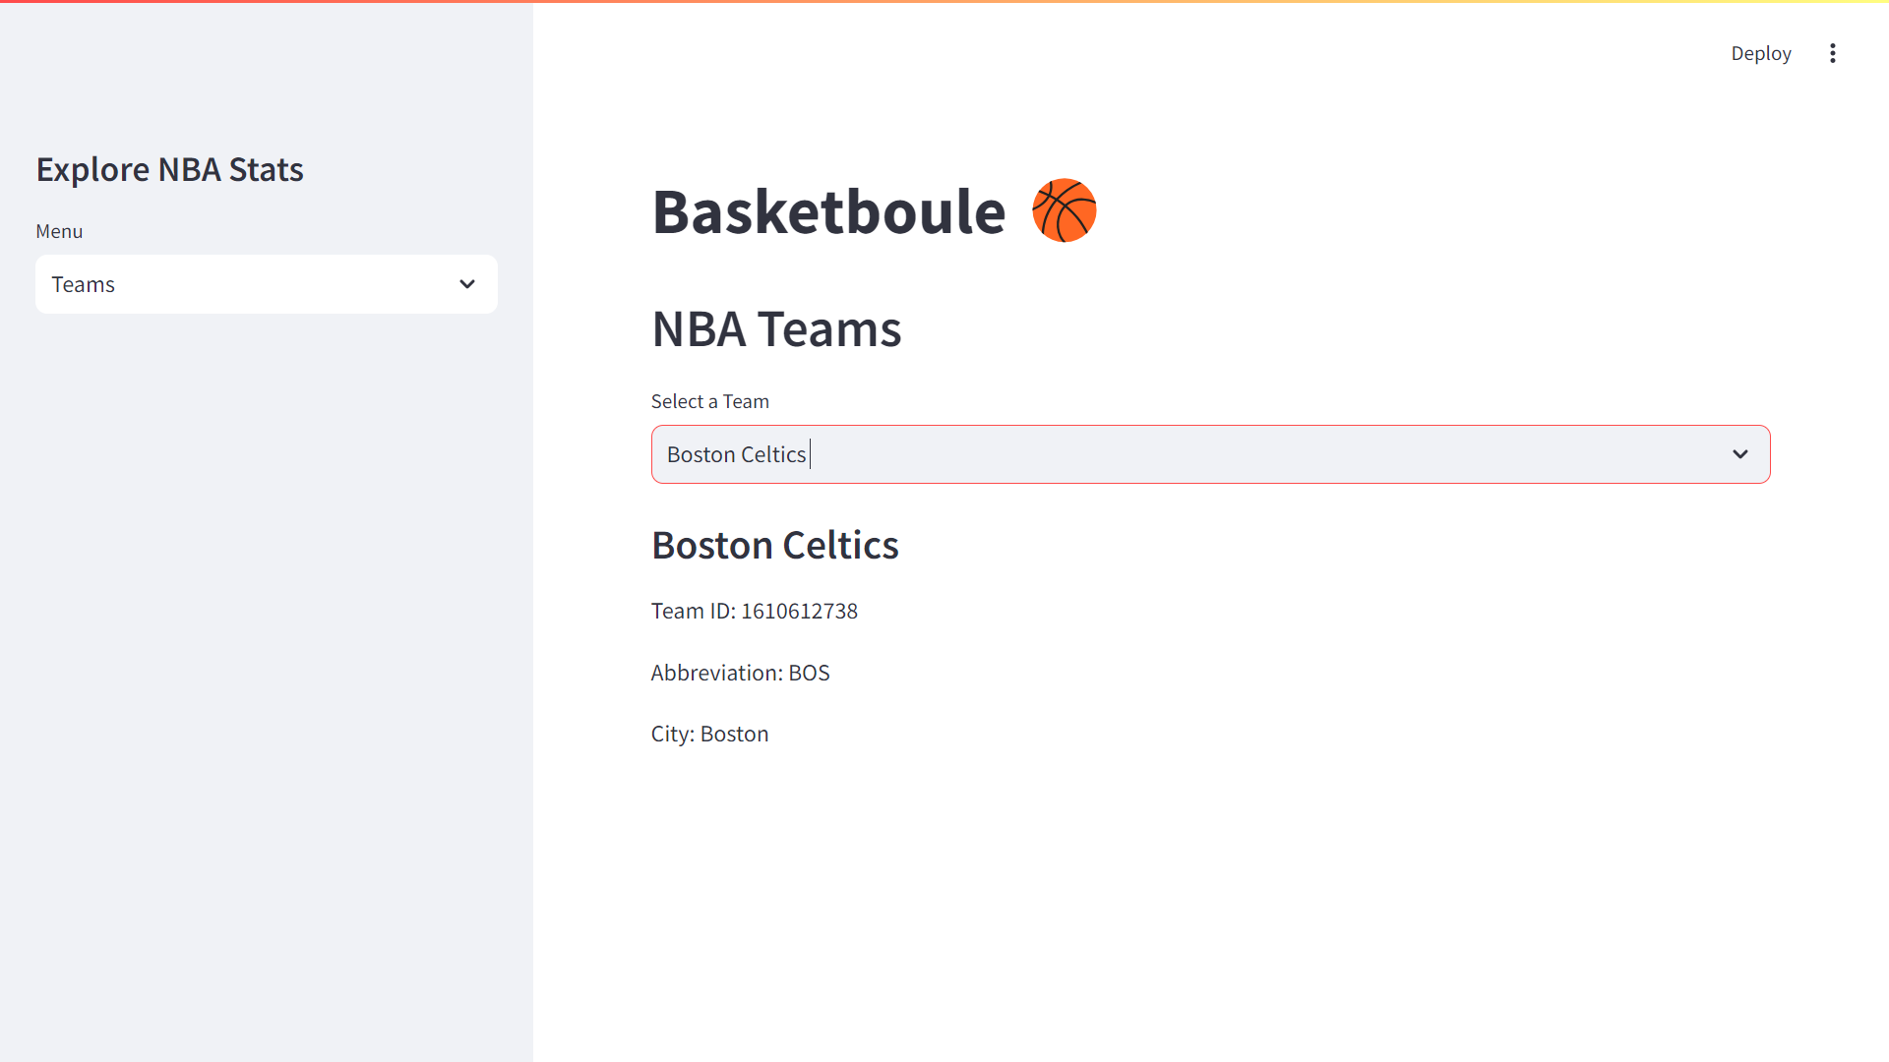

Slide 17
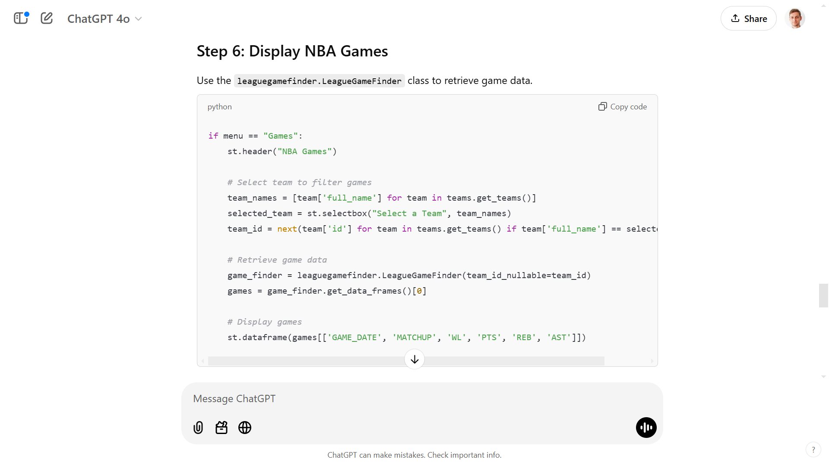

Slide 18
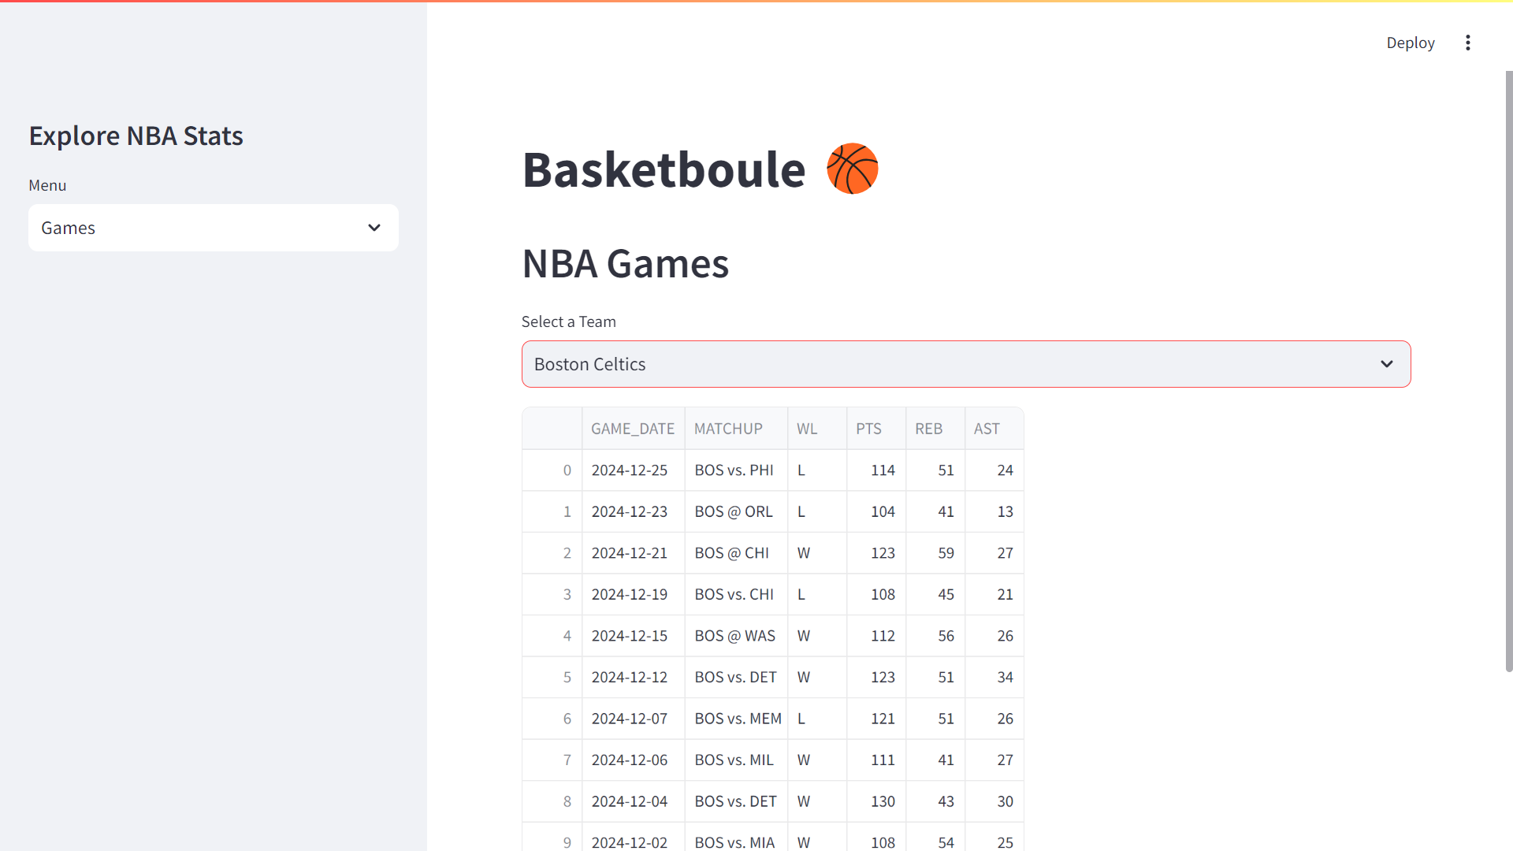
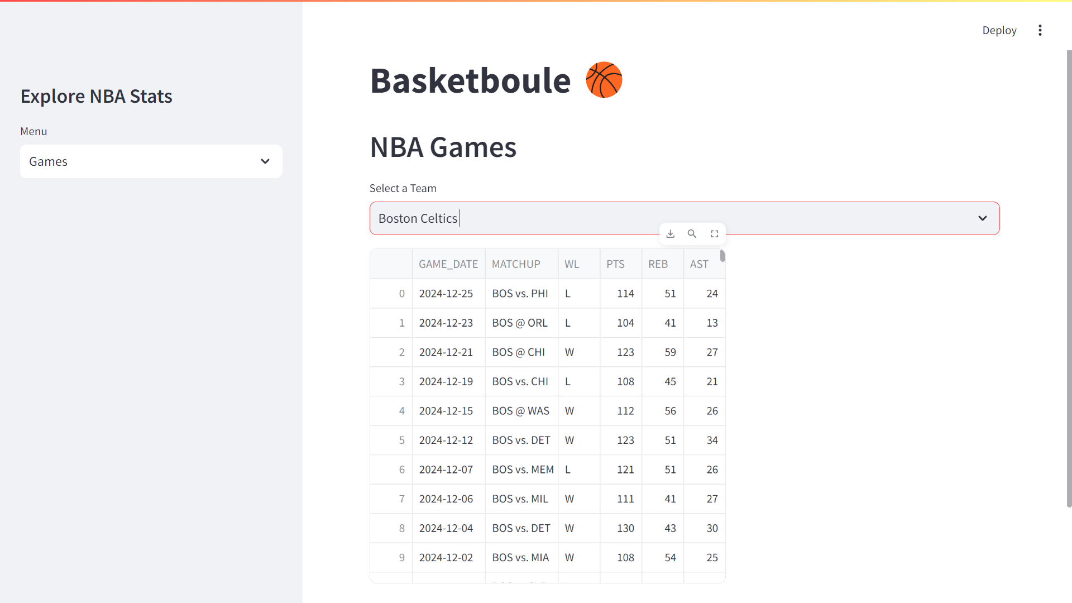

Slide 19
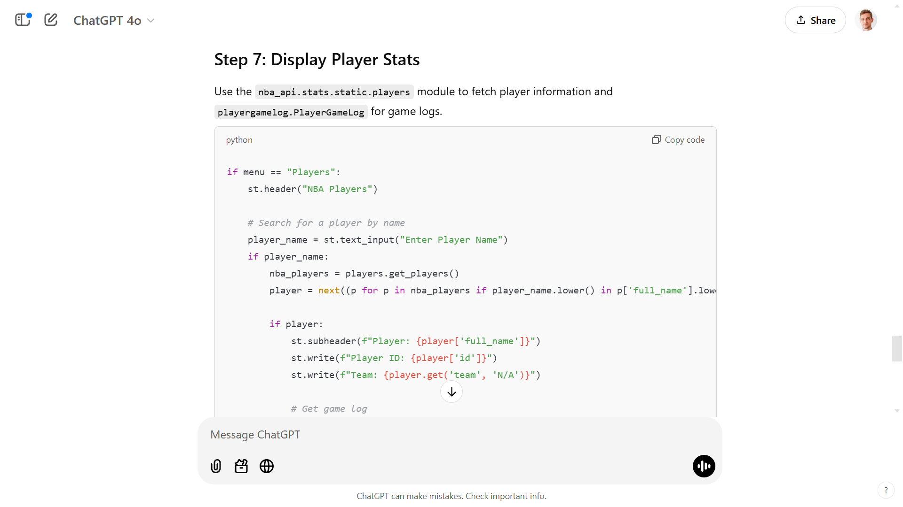
Notes:
if menu == "Players":
st.header("NBA Players")
# Search for a player by name
player_name = st.text_input("Enter Player Name")
if player_name:
nba_players = players.get_players()
player = next((p for p in nba_players if player_name.lower() in p['full_name'].lower()), None)
if player:
st.subheader(f"Player: {player['full_name']}")
st.write(f"Player ID: {player['id']}")
st.write(f"Team: {player.get('team', 'N/A')}")
# Get game log
player_log = playergamelog.PlayerGameLog(player_id=player['id'])
games = player_log.get_data_frames()[0]
# Display recent game performance
st.write("Last Game Performance")
st.dataframe(games[['GAME_DATE', 'MATCHUP', 'PTS', 'REB', 'AST', 'STL', 'BLK']].head(1))
else:
st.warning("Player not found. Try again.")

Slide 20
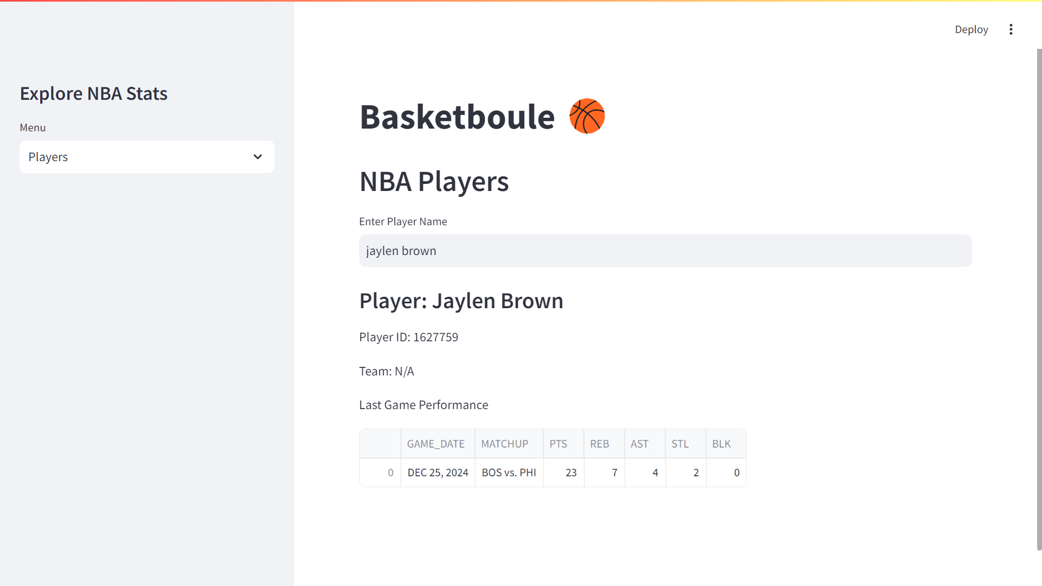

Slide 21
